Slide 1
VASAVI COLLEGE OF ENGINEERING Department of Information Technology MINI PROJECT REVIEW - 1
Date:19/11/22

Slide 2
Hello!
Team members:
M.Teja 1602-21-737-120
Ch.Vignesh 1602-21-737-124
K.Vikas 1602-21-737-125
S.Bharath 1602-21-737-313

Slide 3
Abstract path finding
Path finding is all about finding the shortest path between point two given points. It as some obstacles in between them and we need to find shortest path by avoiding that obstacles.This project is made using Python

Slide 4
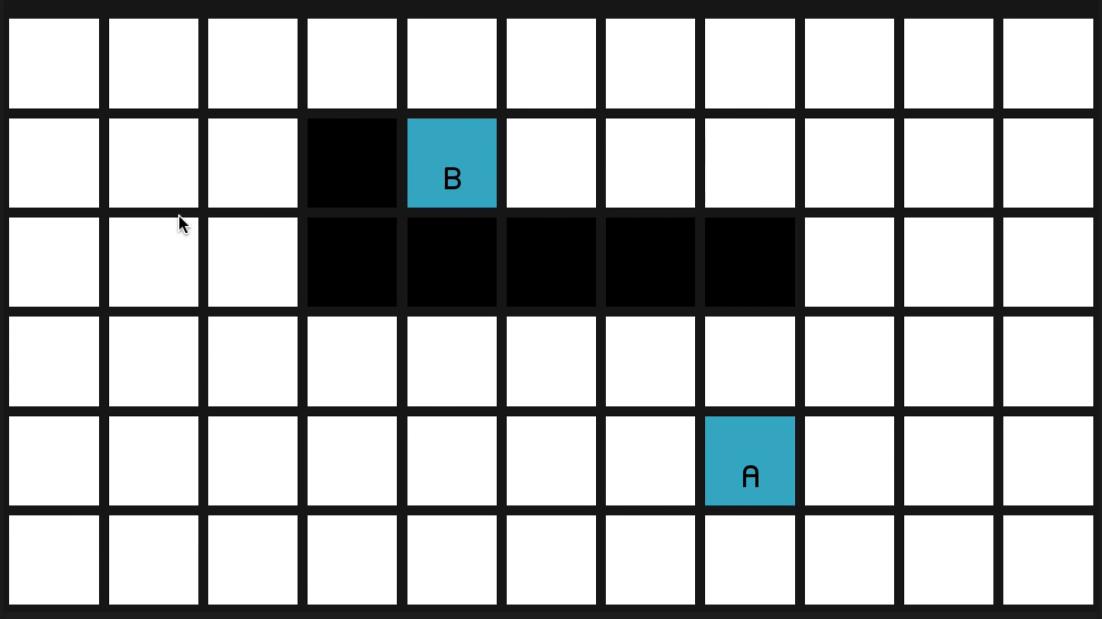
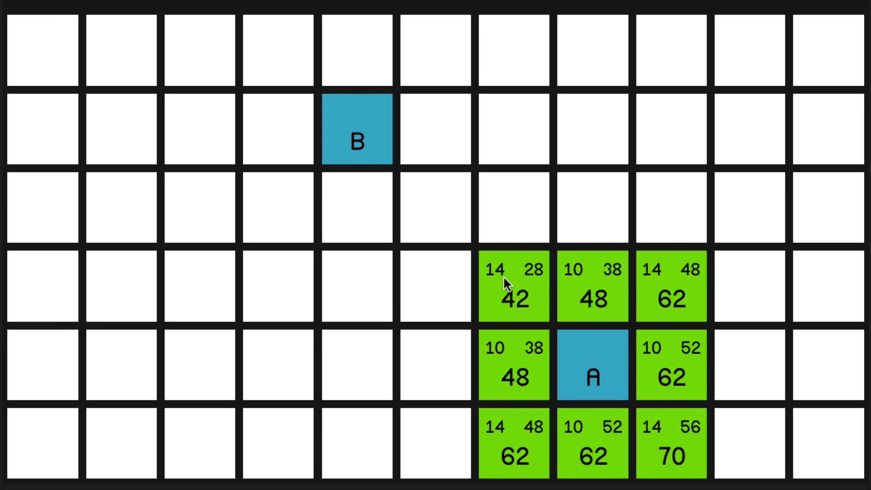
introduction
>Here A and B are two points and black is the obstacle between them.
>At first we need calculate distances of the surrounding nodes of point A to the points A and B, i.e G (n) and H (n).
>Then we need to add both the distances and compare the values of surrounding nodes of point A.
F(n)= G(n) + H(n)

Slide 5
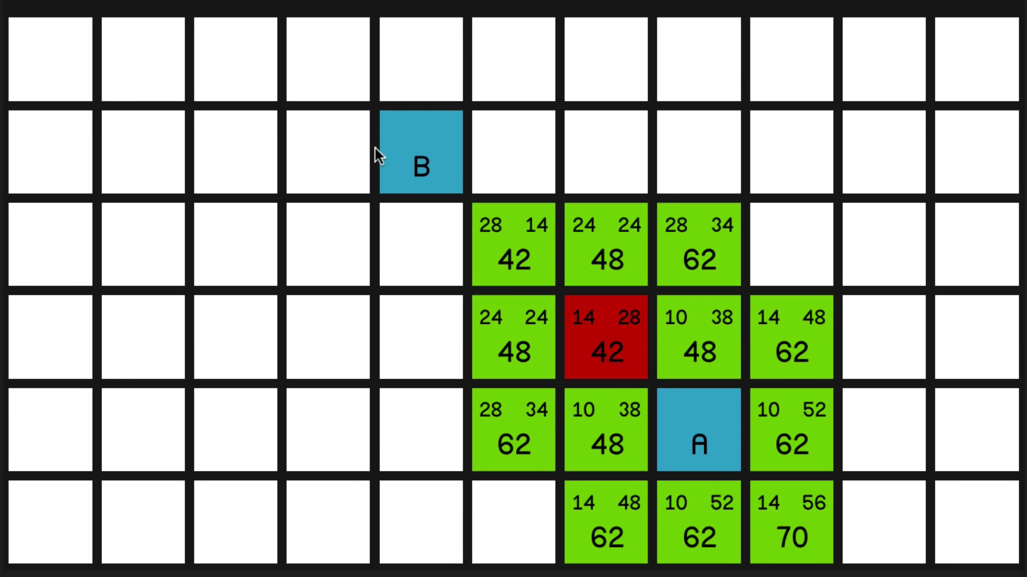
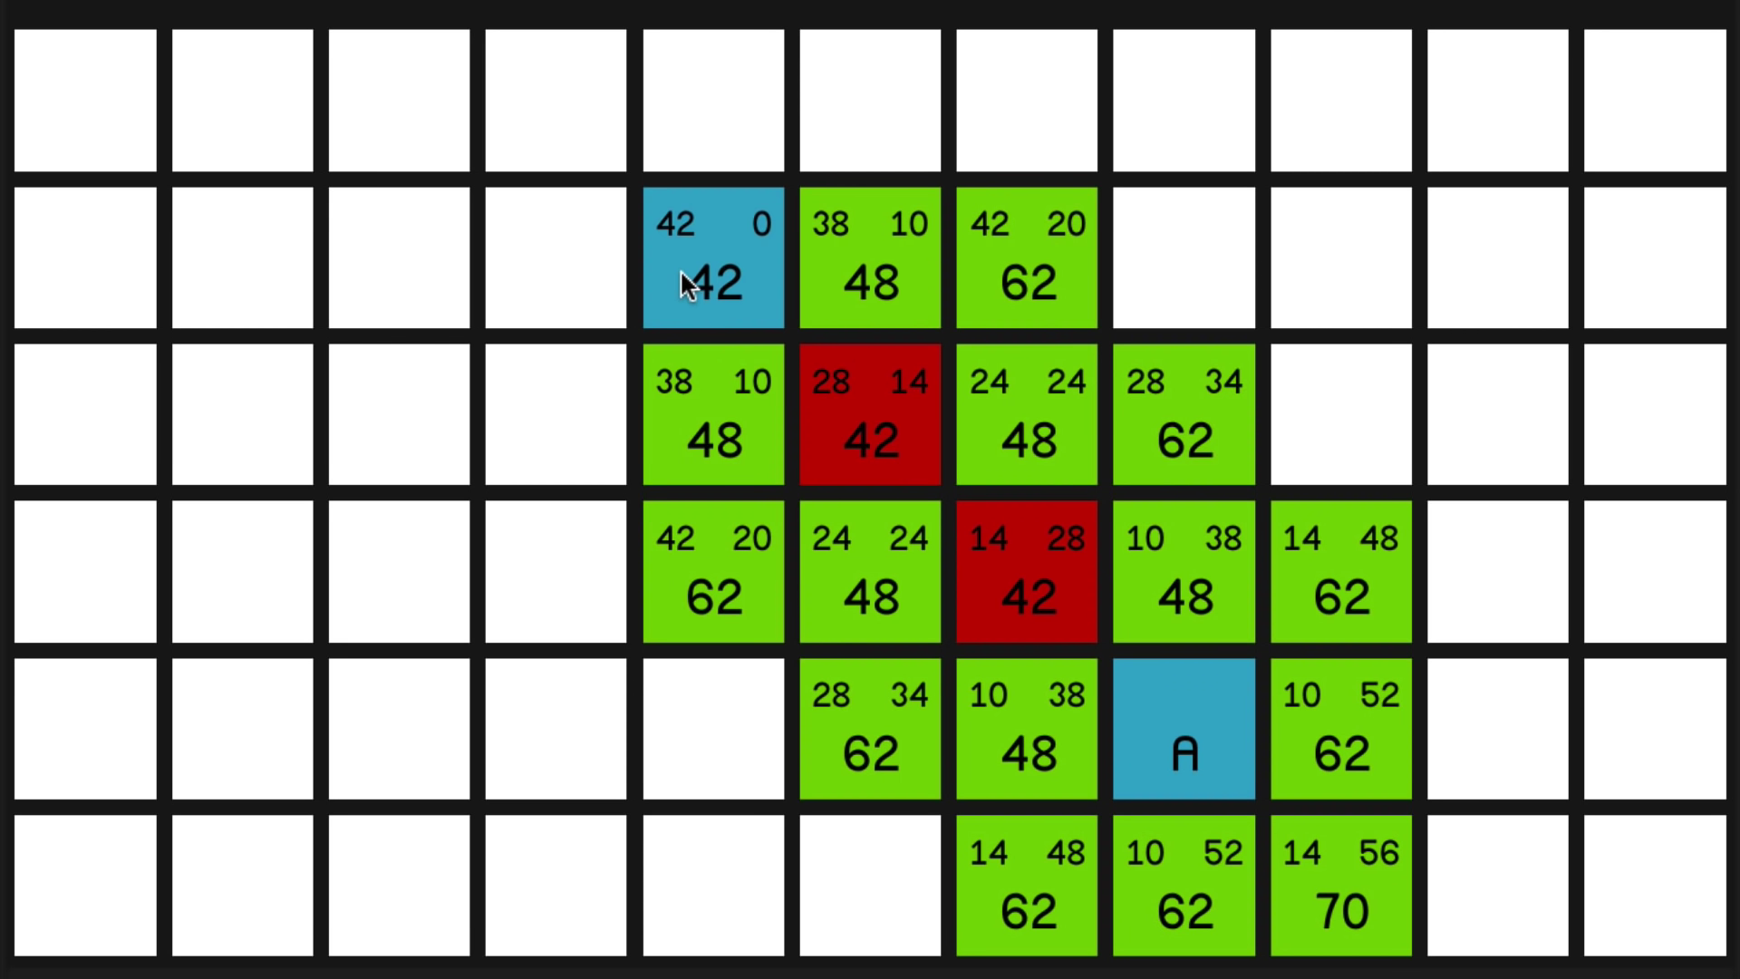
introduction
>Then we need to select least value around the A.
>We have select that node and we need to repeat the same process.
>After some steps we reach to point B. So that we get shortest path between path A and B.

Slide 6
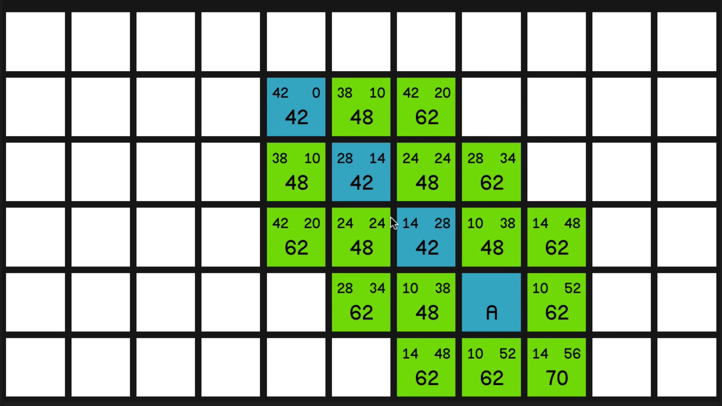
Introduction
>As we can see in figure, green indicates the value around the select node,red indicate the least value till it reaches point b
>After reaching point B all the red points becomes blue and we get shortest distance between point A and B.

Slide 7
existing system Proposed system
Most of the existing systems use Dijkstra’s Algorithm to find the path.
A*algorithm is a smart algorithm it separates it from other conventional algorithm i.e Dijkstra’s Algorithm.

Slide 8
Hardware requirements software requirements
Laptop/desktop,
Minimum 1gb of ram
Py game moudle,
Python ide

Slide 9
references
https://youtu.be/JtiK0DOeI4A
https://www.geeksforgeeks.org/a-search-algorithm/
https://en.m.wikipedia.org/wiki/A*_search_algorithm

Slide 10
Conclusion
In this project we get to know how to implement A*algorithm using Queue data structure along with pygame moudle

Slide 11
Thanks!
Any questions?

